Slide 1
Capstone Project-1 Hotel Booking Analysis
Team Members Bandna Thakur Shivraj Saude Saurabh Waghmare Prerit Tyagi Saurav Sharma

Slide 2

Contents :
Problem statement
About our dataset
Preparing the dataset
Data Visualisation
Hypothesis
Conclusion

Slide 3
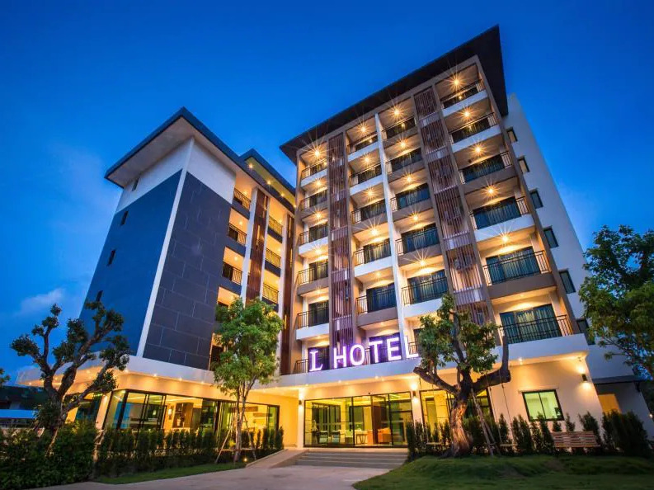
Importance of Hotel Booking Analysis ?
Hotel industry is a very volatile industry and the bookings depend on variety of factors such as type of hotels, seasonality, days of week and many more.
Hospitality industry is big contributor to economic growth of any country.
This makes analyzing the patterns available in the past data more important to help the hotels plan better.
Using the historical data, hotels can perform various campaigns to boost the business.
We can use the patterns to predict the future bookings using time series or decision trees.
The growth in the hospitality sector and its contributions to the GDP will continue to be substantially increase.

Slide 4
Dataset
hotel: Types of Hotels: Resort Hotel, City Hotel
is_canceled: Value indicates booking was canceled (1) or not (0)
lead_time: Number of days between the booking date and the arrival date
arrival_date_year: Year of arrival date
arrival_date_month: Month of arrival date
arrival_date_week_number: Week number of year for arrival date
stays_in_weekend_nights: Number of weekend nights (Saturday or Sunday) the guest stayed or booked to stay at the hotel
arrival_date_day_of_month : Day of arrival date
stays_in_week_nights: Number of weeknights (Monday to Friday) the guest stayed or booked to stay at the hotel
Adults: Number of adults
Children: Number of children
Babies: Number of babies
Meal: Type of meal booked. Categories are presented in standard hospitality meal packages: Undefined/SC – no meal package; BB – Bed & Breakfast; HB – Half board (breakfast and one other meal – usually dinner); FB – Full board (breakfast, lunch, and dinner)
country: Country of origin.

Slide 5
market_segment: Market segment categories, “TA” :“Travel Agents” , “TO” : “Tour Operators”, Aviation, Complementary, Corporate, Direct, Groups.
distribution_channel: Booking distribution channel. The term “TA” means “Travel Agents” and “TO” means “Tour Operators”, Corporate, Direct.
direct is_repeated_guest: Value indicates if the booking name was from a repeated guest (1) or not (0).
previous_cancellations: Number of previous bookings that were canceled by the customer prior to the current booking.
previous_bookings_not_canceled: Number of previous bookings not canceled by the customer prior to the current booking.
reserved_room_type : Code of room type reserved (A,B,C,D,E,F,G,H).
assigned_room_type : Code for the type of room assigned to the booking (A,B,C,D,E,F,G,H,I,J,K).
booking_changes: Number of changes made to the booking from the moment the booking was entered until check-in or cancellation.
deposit_type: This variable has categories: No Deposit – no deposit was made; Non-Refund – a deposit was made in the value of the total stay cost; Refundable – a deposit was made with a value under the total cost of the stay.
agent: ID of the travel agency that made the booking.

Slide 6
company: ID of the company that made the booking or is responsible for paying the booking.
days_in_waiting_list: Number of days the booking was in the waiting list before it was confirmed.
customer_type: Types of customer four categories: Contract - when the booking has an allotment or other type of contract associated with it; Group – when the booking is associated to a group; Transient – when the booking is not part of a group or contract and is not associated to other transient bookings; Transient-party – when the booking is transient but is associated to at least other transient bookings
adr: Average Daily Rate as defined by dividing the sum of all lodging transactions by the total number of staying nights.
required_car_parking_spaces: Number of car parking spaces required by the customer.
total_of_special_requests: Number of special requests made by the customer.
reservation_status: Reservation status contains three categories: Canceled – booking was canceled by the customer; Check-Out – customer has checked in but already departed; No-Show – the customer did not check in and didn’t inform the hotel its the reason.
reservation_status_date: Date at which the last status was set.

Slide 7
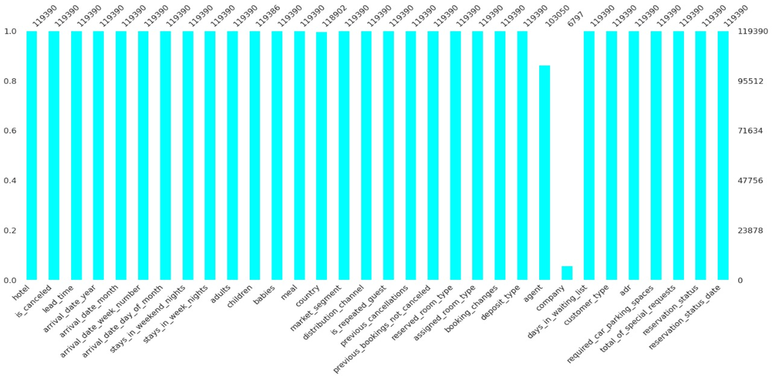
Preparing our dataset :
Libraries used : NumPy, Pandas, Seaborn, Matplotlib.
Shape : 119390 (rows), 32 (columns).
Most of the null values were present in columns : company and agent.

Slide 8
Exploratory Data Analysis

Slide 9


VISUALIZATION

Slide 10
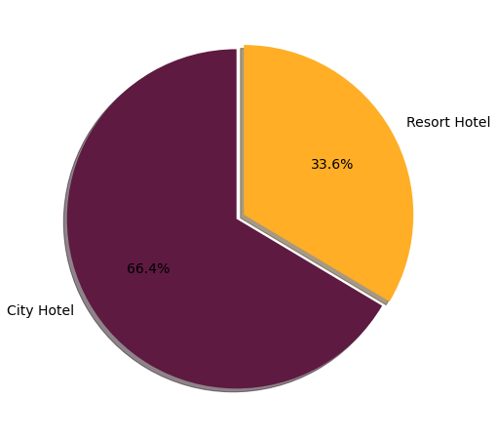
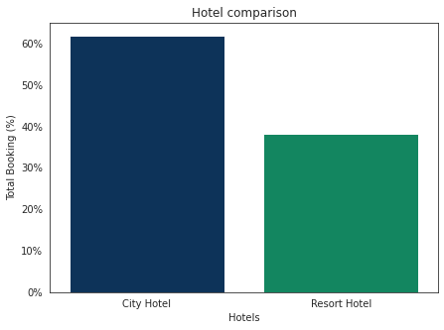
What is the Total Number of Bookings of both hotel types?
We can see that the percentage of City hotels is more compared to Resort hotels in terms of bookings.

Slide 11
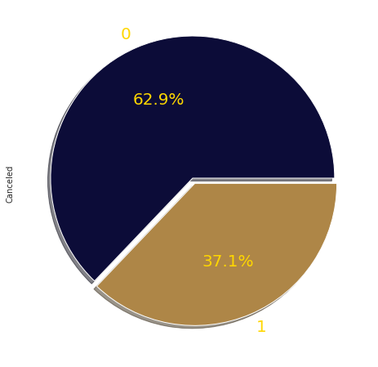
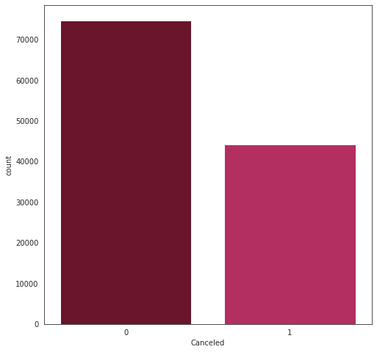
Overall Cancellation Ratio:-
Majority of bookings were cancelled on the spot or at the hotels.
According to the pie chart, 63% (74745) of bookings were not cancelled and 37% (44153) of the bookings were cancelled at the Hotel.

Slide 12
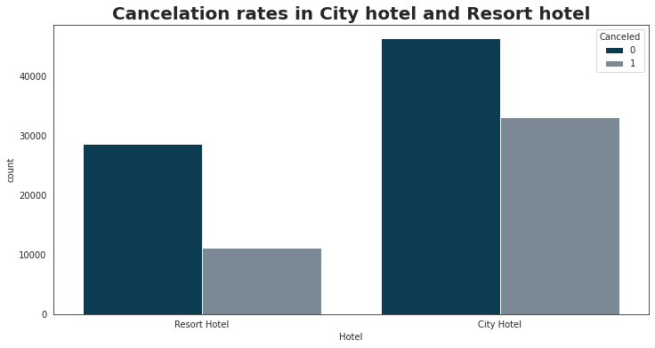
In which Hotels cancellation rate is high?
Mostly the bookings were done from City hotels than Resort hotels.
But the Cancellation rate is also HIGH in City hotels compared to Resort hotels.

Slide 13
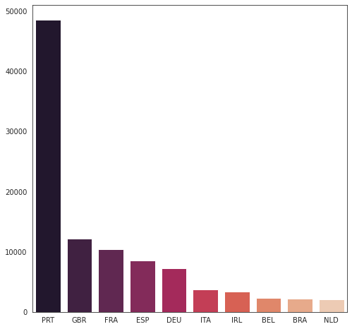
From which countries most of the guests came ?
More visitors are from western Europe, namely Portugal being the Highest, Great Britain(UK), France and so on...

Slide 14
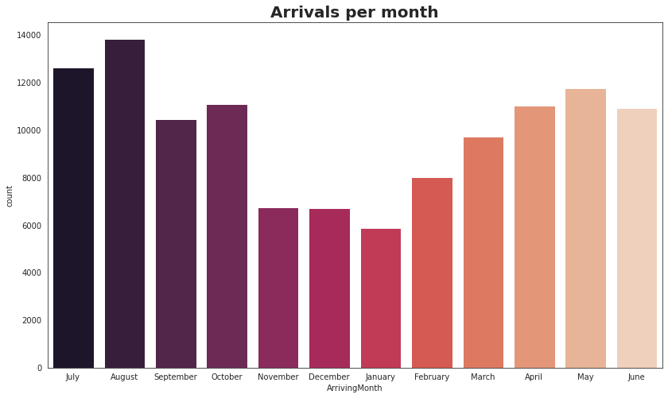
Which are the busiest months for hotel ?
Most bookings were done in the month of August, July, May, June, and so on...
August is the most occupied (busiest) month with 11.62% bookings and January is the most unoccupied month with 4.96% bookings.

Slide 15
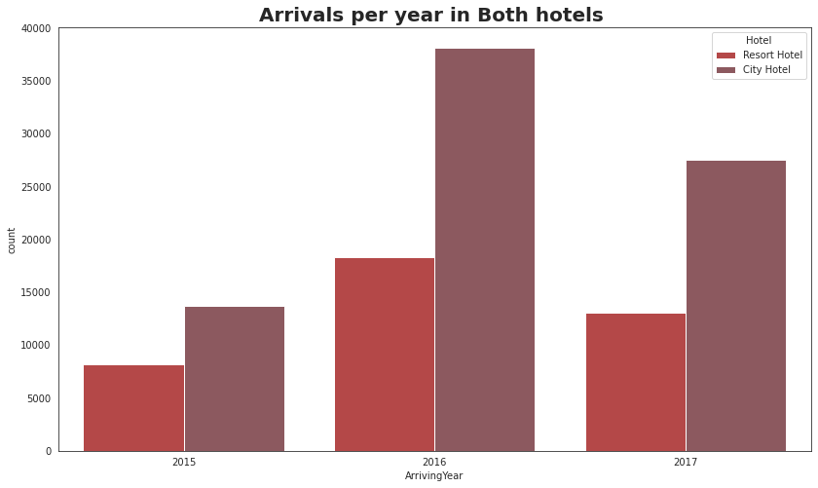
In which years maximum bookings are done for both hotels?
47% of bookings were done in the year 2016, then 34% in 2017 and 18% in 2015.
We can see the increasing tendency in bookings year wisely.
We can see most of the bookings were in the year 2016 and highest bookings were from City hotels.

Slide 16
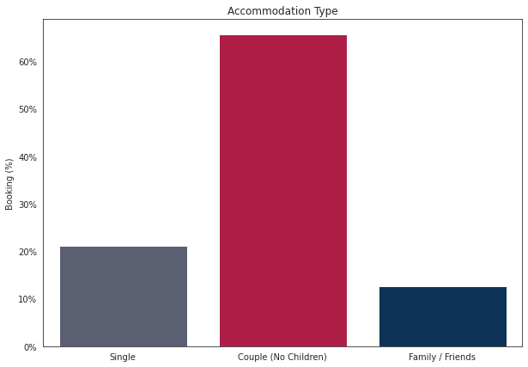
Which was the most booked accommodation (Single,Couple,Family)?
The highly booked Accommodation was for Couples, then Single and Family/Friends.

Slide 17
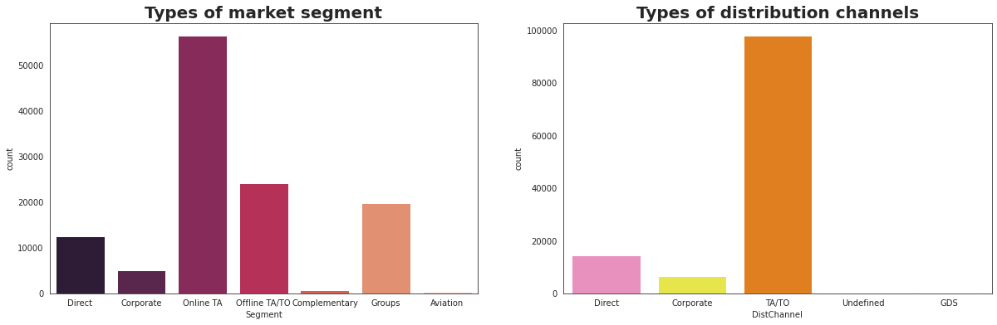
What are the Market Segment of both hotels?
Majority of Market segments and Distribution channels is Travel agencies(offline/online).

Slide 18
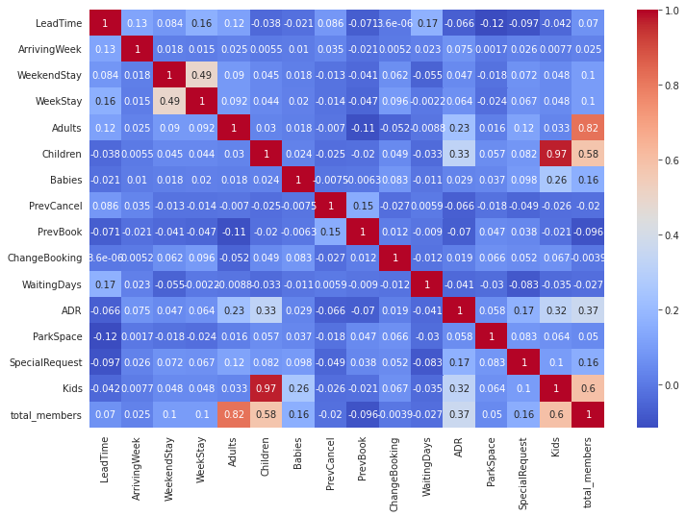
Extracting the correlation using Heatmap.

Slide 19

HYPOTHESIS

Slide 20
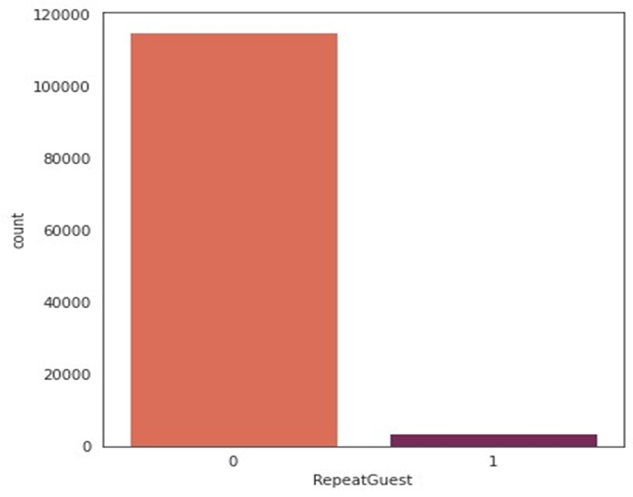
New Guest & Repeated Guests Count:
Repeated guests(1) are very less comparative to New guests(0)
The ratio of New guests is high then Repeated guests.

Slide 21
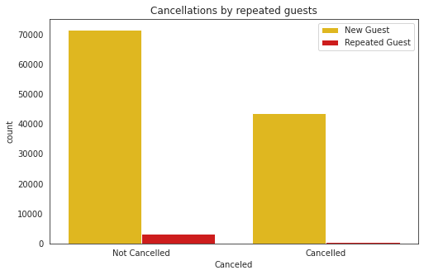
Cancellations by type of Guests (Repeated/NonRepeated) :-
We observed that New Guests CANCELS their bookings more than the Repeated Guests.

Slide 22
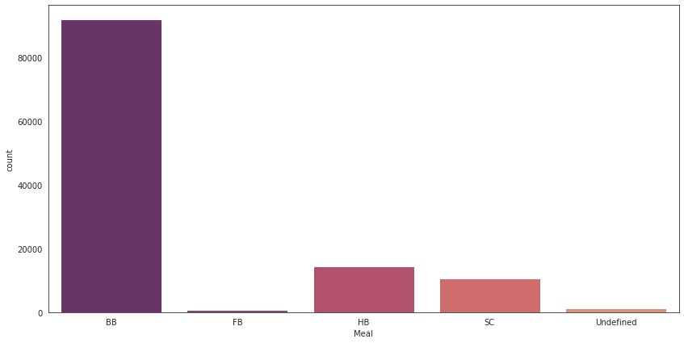
Most popular meal type?
Type of meal booked. Categories are presented in standard meal packages:-
Undefined/SC — no meal package.
BB — Bed & Breakfast.
HB — Half board (breakfast and one other meal — usually dinner).
FB — Full board (breakfast, lunch, and dinner).
BB Meal plan is most popular meal plan followed by HB.

Slide 23
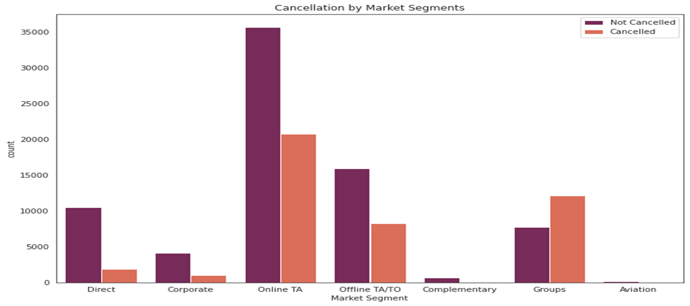
Cancellation by Market Segments:-
Almost 95%, cancellations are from online TA , offline TA and group segments.
Online TA has the highest cancellations of around 50%, followed by groups and offline TA.

Slide 24

Conclusions

Slide 25
City hotel was booked in the majority. So it’s good to spend the most targeting fund on these hotels.
Cancellation ratio of a city hotel is high than resort hotel though city hotels bookings are also high compared to resort hotels.
Many guests come from Western European countries. So hotels should spend a significant amount of budget in these areas.
May to August is the busiest month so the hotels should target more customers in this period and try to do more business for profit.
Most customers are couples and bringing kids along with them is rare so the hotels should advertise in such a way that it attracts the couples more.
In the Market segment many of the hotel bookings are done from Travel agencies (online and offline).
Encourage Direct bookings by offering special discounts.
Hotel has low repeated guests, Hotel should depend on online marketing companies for advertising to increase the repeated guests.
New Guests cancel the most than the repeated guests.
In food most popular meal plan was BB(Bed & Breakfast) preferred by guests.

Slide 26

Thank you

